Slide 1
MBA:PEOPLE MORALE

Slide 2
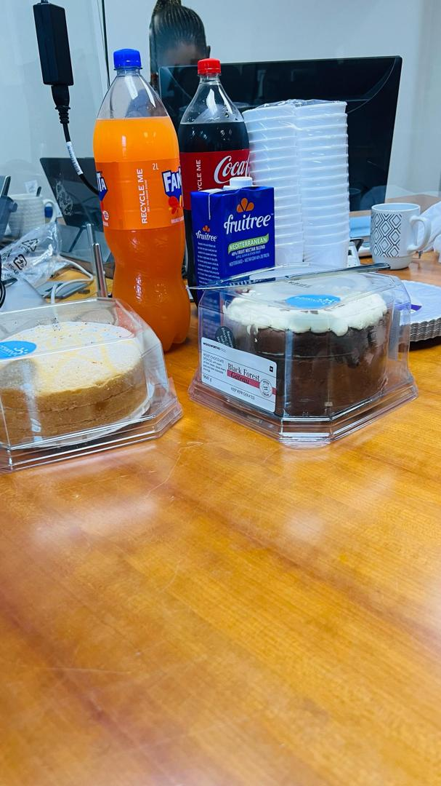
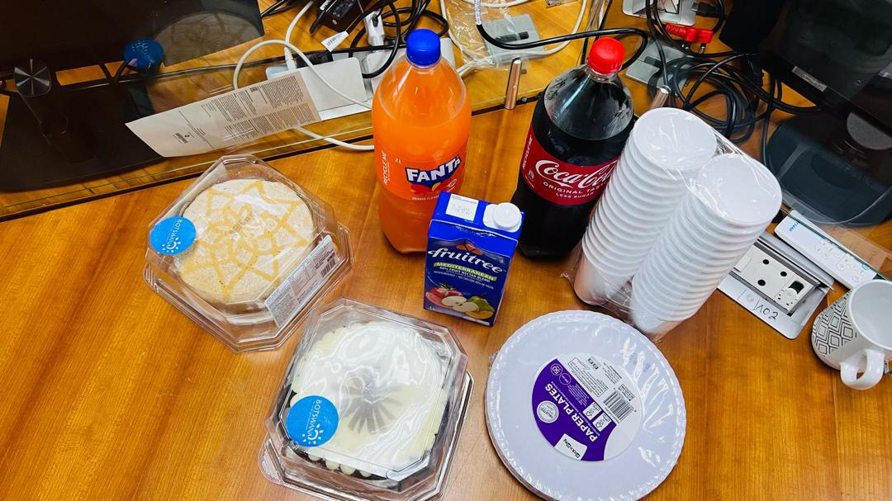
BIRTHDAY CELEBRATION

Slide 3
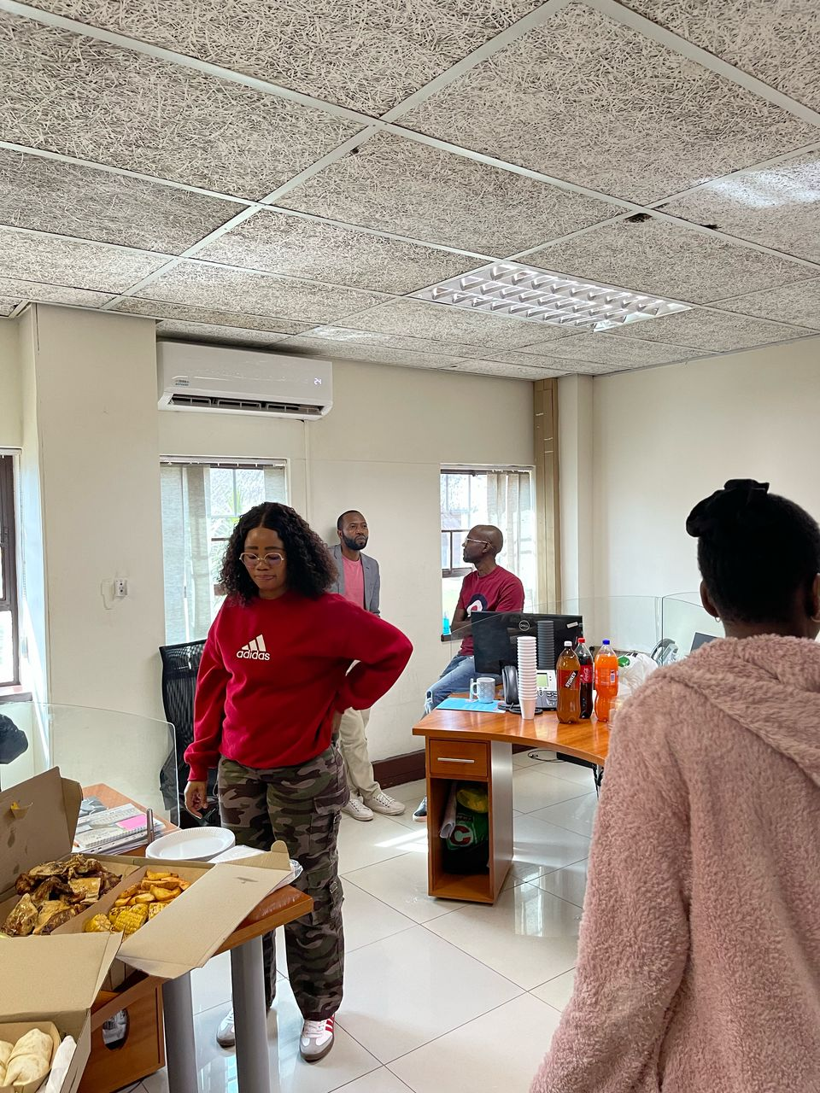
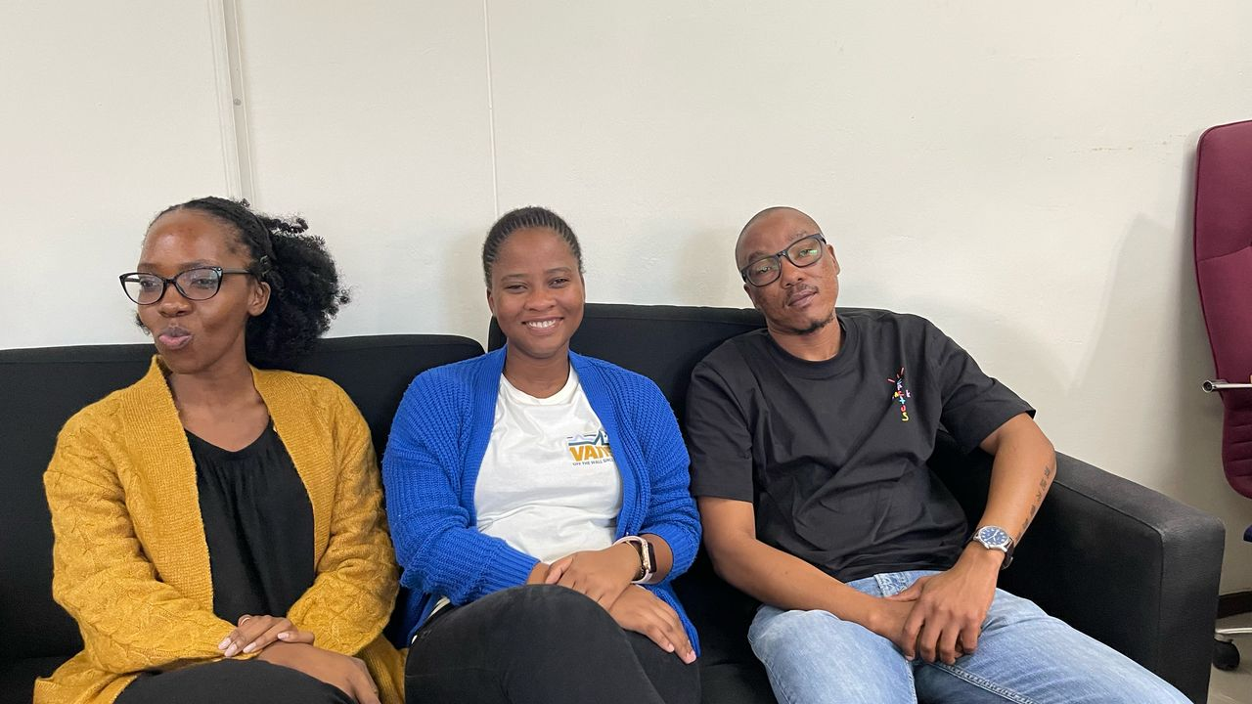
FAIRWELL PARTY

Slide 4


